Slide 1
Resilient Leadership:
The Transformative Path Through Adversity

Slide 2
Premise
It is my supposition that for the rewarding but difficult work of revitalization to occur, those who lead this process must be people of deep character and proven competence. The foundational quality that ties both of these needed qualities together is resilience.

Slide 3
Objectives
Define what it is
Demonstrate ways it is illustrated
Deliver a model for measuring it

Slide 4
What is resilience?
Resilience is the ability to bounce back from crisis, conflict or change with endurance and wisdom which results in an increase of one’s overall effectiveness.

Slide 5
What is leadership?
Leadership is the catalytic process whereby a person helps others to move towards accomplishing an aspirational objective.

Slide 6
What is resilient leadership?
Resilient Leadership is the ability to leverage what you have learned to help others who are discouraged, fearful or confused so that they can move through hardship in a developmental fashion.

Slide 7
Qualities of resilient leadership
The Resilient Leader is passionate
The Resilient Leader is empathic
The Resilient Leader is gritty

Slide 8
Passion & Resilience
Many assume that in order to become resilient you have to have a large amount of discipline. While discipline is important, a more primary quality that needs to be in place is a desire to fulfill God’s plan for your life. It is this desire that moves you through difficulty and embrace new opportunities.

Slide 9
Passion & Resilience
“Therefore, since we are surrounded by so great a cloud of witnesses, let us also lay aside every weight, and sin which clings so closely, and let us run with endurance the race that is set before us, looking to Jesus, the founder and perfecter of our faith, who for the joy that was set before him endured the cross, despising the shame, and is seated at the right hand of the throne of God” (Heb. 12:1-2).

Slide 10
Passion & resilience
A cue to think of those who finished well (follow in their footsteps)
A call to live with purpose (get rid of distractions & defilements)
A comfort for weary travelers (Jesus’ passion to win your salvation is your lifeline)
We have passion for the mission because of how we are passionately pursued.

Slide 11
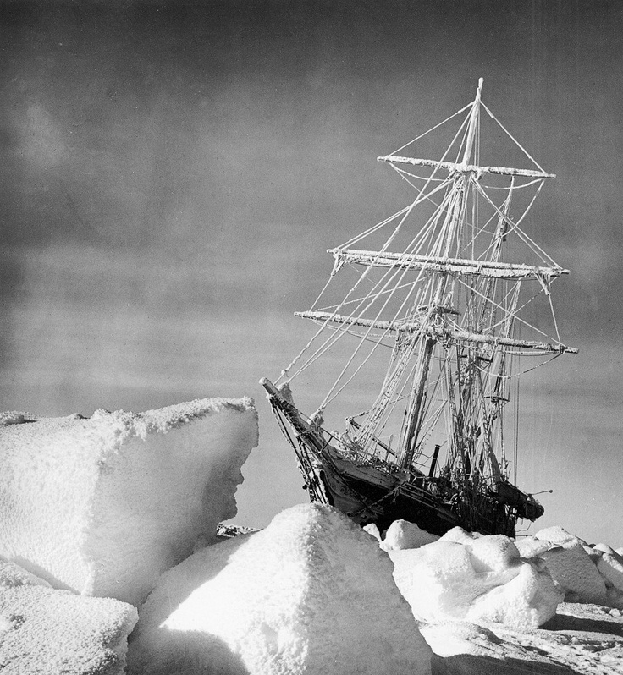
Passion & resilience

Slide 12
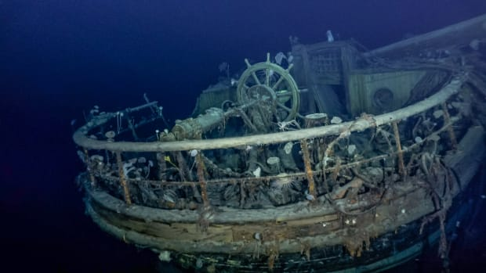
Passion & resilience

Slide 13
Passion & resilience
“Men wanted for hazardous journey. Low wages, bitter cold, long hours of complete darkness. Safe return doubtful. Honour and recognition in event of success.”

Slide 14
Passion & resilience
The mission of The Endurance was to be the first expedition to cross the Antarctic on foot from 1914-1917.
The Endurance left England August 14th 1914 with 27 crew, 69 dogs, 1 cat and ample supplies (including 25 barrels of whiskey).
A few months later while aiming to land at Vahsel Bay, it became stuck in an ice pack on the Weddell Sea in February 1915, or as one crew member put it, “like a piece of almond in the middle of a chocolate bar.” Nine months later it sank.
From that point forward the mission moved from adventure to survival, and in turn, prophetically fulfilled it’s name. (Insights gleaned from www.artofmanliness.com)

Slide 15
Passion & resilience
The men of The Endurance volunteered because they had a desire for glory, discovery and adventure. Shackleton sifted through 5,000 applications to find the right men.
Their ambition was tested and transformed by adversity.
Adversity is the crucible on which resilience is forged and the anvil on which it is formed.
Only the fire of a great desire will provide the necessary fuel to move you through adversity.

Slide 16
Passion & resilience
Who inspires you? Why do they inspire you?
What inspires you? What are you willing to endure to see your desire fulfilled?
How does Jesus’ passionate sacrifice for you reorder and relight your desires?

Slide 17
empathy & Resilience
Resilient Leadership is not merely focusing on and pursuing our objective. It also involves bringing others along. Whatever we have learned is to not only benefit us but also bless others. Think of the race of life as a relay. Empathy in this context means connecting with people and handing off what you have learned in order to boost them forward. Resilience is not only a point of personal growth but also a team sport.

Slide 18
empathy & Resilience
“Since then we have a great high priest who has passed through the heavens, Jesus, the Son of God, let us hold fast our confession. For we do not have a high priest who is unable to sympathize with our weaknesses, but one who in every respect has been tempted as we are, yet without sin. Let us then with confidence draw near to the throne of grace, that we may receive mercy and find grace to help in time of need (Heb. 4:14-16).

Slide 19
empathy & Resilience
Jesus is our conquering king who has won our rest.
Jesus is our compassionate priest who understands our struggles.
Jesus is our ceaseless advocate who is always ready to meet our weaknesses with mercy and grace.
We give empathy because we are on the receiving end of it.

Slide 20
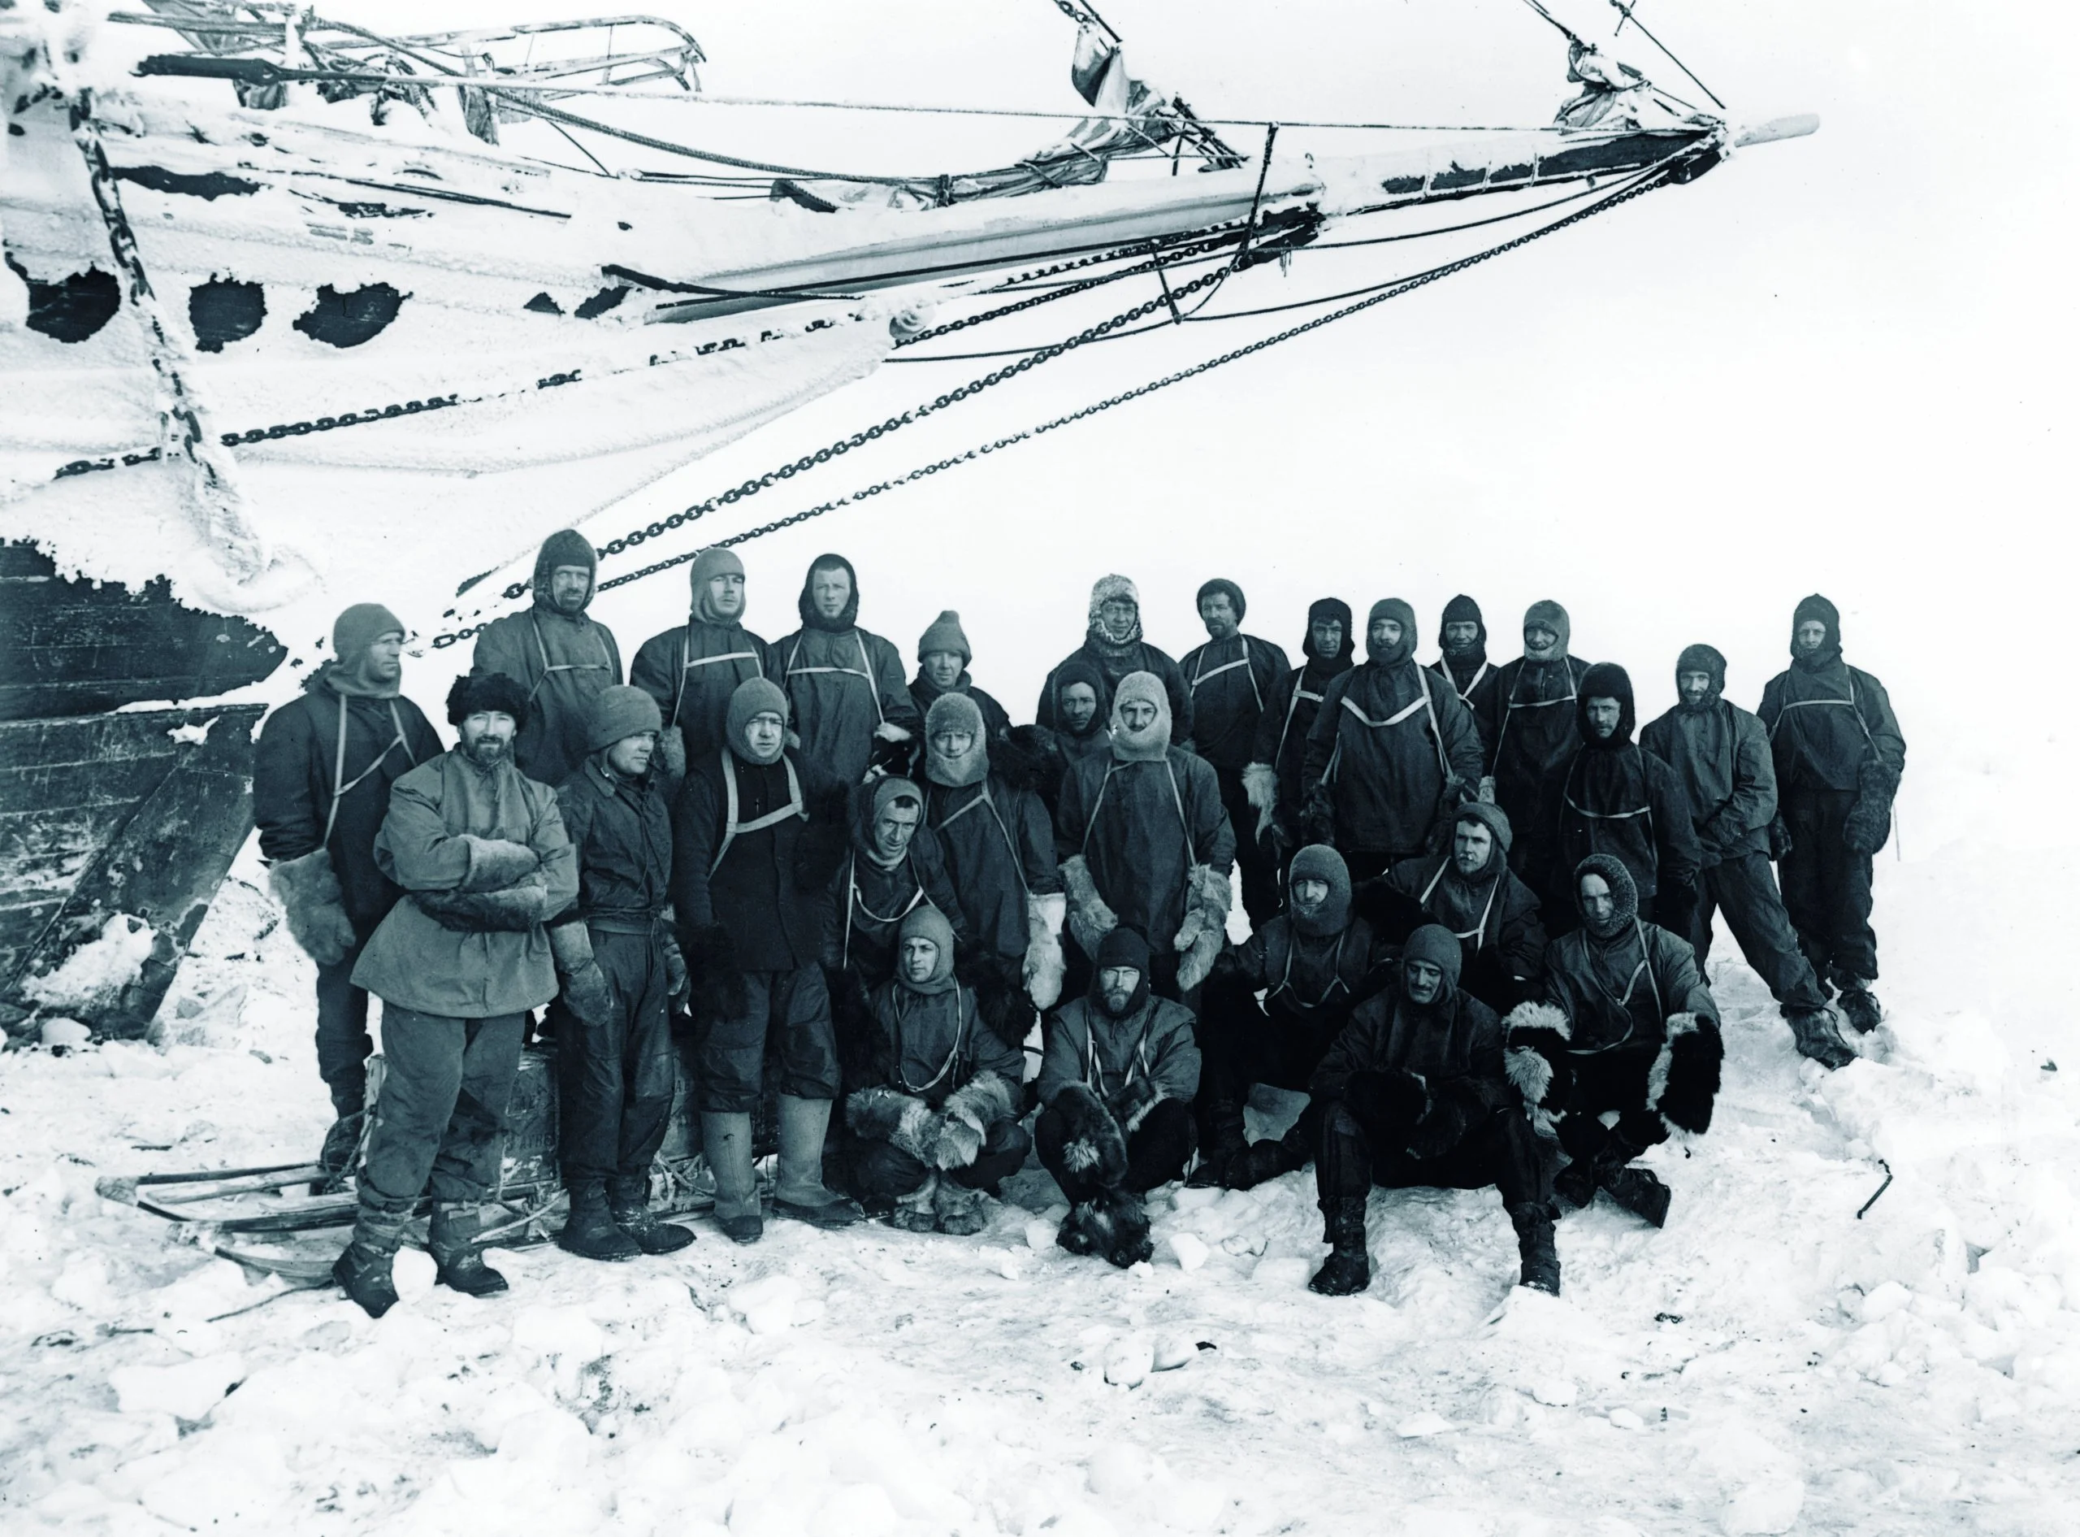
empathy & resilience

Slide 21
empathy & Resilience
One of Shackleton's crewman named Whaley commented on Shackleton's commitment to his crew, “bitterly disappointed, as sorely grieved as I was myself, and he let me get a glimpse of his mind when he said, sadly, one day: “It looks as though we shan’t cross the Antarctic Continent after all.” He paused, and then squaring his shoulders, added cheerfully, ‘It’s a pity, but that cannot be helped. It is the men that we have to think about.’”

Slide 22
empathy & Resilience
Shackleton was ever concerned about his men’s morale. He understood that idleness quickly begets depression, and so he kept the men as active as possible, sending them out for vigorous games of football and hockey while the Endurance was trapped in ice. This is also why he chose to attempt the marches across the ice once the ship sank.
On the way to South Georgia, he assured that the men got regular meals and drinks of hot milk every four hours; the routine gave the men stability and something to look forward to.

Slide 23
empathy & Resilience
When they sailed to Elephant Island, the expedition’s photographer, Frank Hurley, lost his mittens, so Shackleton gave him his own; when Hurley protested, Shackleton threatened to throw them overboard. Hurley accepted the mittens, and Shackleton’s fingers became frostbitten.
Shackleton thought of himself as the father of the men, and believed it was his responsibility to get every man out alive. This was a great weight to bear upon his shoulders, but he bore it stoically. When they arrived at Elephant Island he exclaimed, “Thank God I haven’t killed any of my men!”

Slide 24
empathy & resilience
Shackleton was a driven and ambitious man, but never lost track of the truth that without the men the mission would never be accomplished.
Shackleton constantly checked in on his men to assess their welfare and state of mind.
Empathy purifies your desires and makes resilience a noble form of determination.

Slide 25
empathy & resilience
Would people say of you that they are cogs in the wheel of your ambition or that they were valued partners in a great enterprise?
What are you doing to feed, nurture and grow your leaders?
How are you sacrificing to see your family and others you lead become all that God intended them to be?

Slide 26
grit & Resilience
To accomplish anything of true value takes dedicated and relentless effort. While we are dependent on the Spirit’s empowerment, the “let go and let God” passive nonsense muddies the picture of the grit it takes to obey God. This is the inglorious glory of daily walking in the way of the Master. Resilience is not only an attribute but also an ongoing tutorial in the step-by-step process of our sanctification.

Slide 27
grit & Resilience
“In the days of his flesh, Jesus offered up prayers and supplications, with loud cries and tears, to him who was able to save him from death, and he was heard because of his reverence. Although he was a son, he learned obedience through what he suffered. And being made perfect, he became the source of eternal salvation to all who obey him, being designated by God a high priest after the order of Melchizedek” (Heb. 5:7-10).

Slide 28
grit & resilience
Jesus fought through the obstacles of suffering to win our salvation.
Jesus flowed with the currents of suffering to secure our salvation.
Jesus fashioned a path for us to gain wisdom in suffering through obedience.

Slide 29
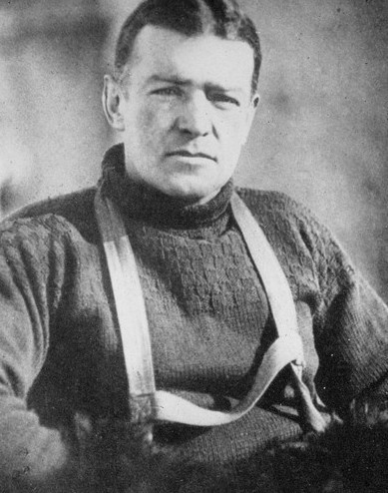
grit & resilience

Slide 30
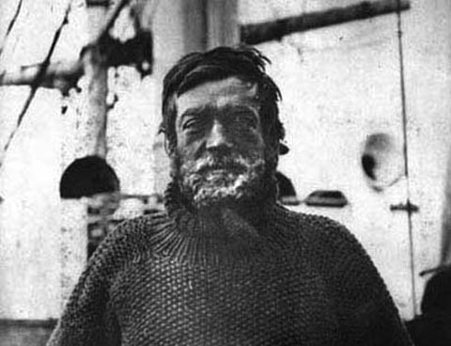
grit & resilience

Slide 31
Grit & resilience
“The quality I look for the most is optimism: especially optimism in the face of reverses and apparent defeat. Optimism is true moral courage”

Slide 32
grit & Resilience
When the ship first gets locked within the ice floes, Shackleton is hopeful that with the Spring thaw they will be able to navigate again. But within a few months, the ship starts to fill will water. He gives the order to abandon ship.
Despite this setback, Shackleton is hopeful again that the men and dogs can pull the supplies and boats across the ice floes until they reach open water, at which point they can set sail for Paulet Island, 346 miles to the northwest. He leads the party, breaking the trail and trying to smooth the pressure ridges with a shovel and pick. But the wet snow soaks the men’s tents and sleeping bags and slows progress considerably. After only making it two miles in two days of marching, the plan is abandoned.

Slide 33
grit & Resilience
After 2 months camped on the ice, Shackleton decides to attempt another march. The men once more leave in high spirits, but again, the progress is so painfully slow that the expedition is quickly abandoned. The men will have to camp for four more months as their icy home drifts for hundreds of miles, their lives completely at the mercy of nature. At one point, the coast of Antarctica comes within sight, but the way is blocked by ice, and Shackleton is forced to slowly slide away from his goal.
After almost six months of living on ice, it finally melts sufficiently for the boats to be launched. The men set off for Elephant Island, which is only 30 miles away.

Slide 34
grit & Resilience
After an arduous day of sailing, Shackleton feels hopeful they are almost there. But when their position is checked, they find they are now 60 miles from their destination—the current has carried them off course.
For seven days, Shackleton and his men row and sail in small, open boats upon the stormy seas. Blocks of ice threaten their path. Rain and snow squalls soak them though. Snow showers dust them in white. The sun is absent for 17 hours a day, and the temperatures dip below zero in the dark. Sleep comes only in tiny, involuntary snatches, and the men are completely exhausted.

Slide 35
grit & Resilience
On the fourth day of the journey, the water supply runs out and the men grow so dehydrated they cannot eat. Elephant Island is spotted, but as they pull close, a strong gale prevents them from landing. For two days they can see their goal but not approach it.
When the men finally make land, they dance along the “beach” and let the pebbles dribble through their hands. This is the first time in 497 days they have been on dry land. They believe that they will be picked by whalers in the Spring.

Slide 36
grit & Resilience
But as Shackleton audits their supplied he finds that they don’t have enough supplies to last. He has to break to his men that they have to get back in the boat to sail another 800 miles to the whaling stations on the island of South Georgia. Shackleton chooses five men to accompany him, loads a boat with a month’s supply of rations, and takes off to their last hope of salvation.
For 13 days, the men are battered by waves and wind, fierce gales, and the constant spray of freezing ocean water, which chills them to the very marrow of their bones. Dehydrated, battered and bruised and without water they see land on the 14th day but can’t approach. Finally, on the 15th day they make land.

Slide 37
grit & Resilience
As soon as the land they recognize that they are on the opposite side of the mountains from the whaling station. Due to bad weather this trip is delayed for 10 days. Once they embark on their mountain-climbing aspect of the journey they travail for 36 sleepless hours they trek through mountainous terrain finally arriving upon civilization.
He they tries three rescue mission to his remaining 22 crewmen but is turned back each time by frozen masses. On his fourth attempt and after four months from his last departure is successful and finds every man alive.

Slide 38
grit & resilience
Shackleton never gave up despite the challenges he faced.
His determination enabled him to be adaptable and creative.
Passion and empathy without grit leads to premature abandonment of the mission.
Grit is a battle not ultimately fought in the body but in the mind.

Slide 39
Grit & resilience
What discouragements, delays and detours have you faced in seeking to lead?
How have you responded?
What do you need to change your thinking and start doing to help you become more gritty?

Slide 40
A Way to Measure Resilience
Walker Armstrong of the PMBA and Rob Peters of Corpus collaborated to form the Leadership Resilience Assessment.
It is a 360 or Multi-Rater Assessment that uses the “fruit of the Spirit” found in Gal. 5:22-23 as a measurement.
It is divided into three major clusters of Spiritual Vitality (passion); Relational Tenacity (empathy); and Personal Stability (grit).

Slide 41
A Way to Measure Resilience
It subdivides each cluster and dives deep into behavioral descriptors of what each fruit looks like.
It can be done online.
The LRA costs $199.
For further information see www.corpusvitae.org/assessments/purchase.

Slide 42
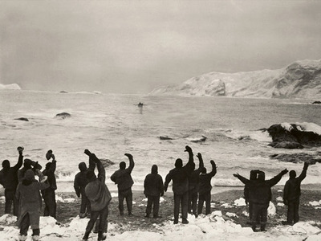
Questions?

